Slide 1
System Testing - Test Selection Techniques
CSE 4495 - Lecture 5 - 25/07/2022
Instructor : Md. Mohaiminul Islam

Slide 2
Creating System-Level Tests
Identify an Independently Testable Function
Identify a function that can be tested in (relative) isolation.
Identify controllable aspects of the input and environment that determine the outcome of the function.
Identify Choices
Identify Representative Input Values
Identify types of values for each choice that lead to different function outcomes.
Generate Test Case Specifications
Combine values to form “recipes” for test cases.
Generate Test Cases
Replace representative values with concrete values.

Slide 3

Test Specifications
May end up with thousands of test specifications.
Which do you turn into concrete test cases?
Identify the important interactions.

Slide 4
Today’s Goals
Understand how interactions can create faults.
Examine how to select system tests to increase likelihood of detecting interaction faults.
Category-Partition Method
Combinatorial Interaction Testing

Slide 5
Internal Interaction
Low-level functions are expected to interact.
Usually this is planned!
Sometimes unplanned interactions break the system.
We want to select tests that thoroughly test interactions.

Slide 6

Triggering Interactions
Interactions result from combining values of individual choices.
Inadvertent interactions cause unexpected behavior
(ex. incorrect output, timing)
Want to detect, manage, resolve inadvertent interactions.

Slide 7

Fire and Flood Control
FireControl activates sprinklers when fire detected.
FloodControl cuts water supply when water detected on floor.
Interaction means building burns down.

Slide 8
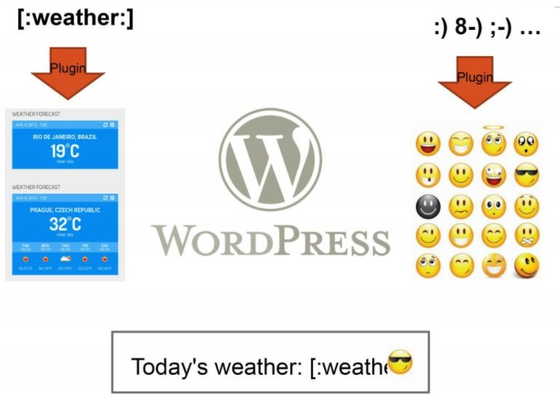
WordPress Plug-Ins
Weather and emoji plug-ins tested independently.
Their interaction results in unexpected behavior.

Slide 9
Selecting Test Specifications
We want to select interesting specifications.
Category-Partition Method
Apply constraints to reduce the number of specifications.
Combinatorial Interaction Testing
Identify a subset that covers all interactions between pairs of choices.

Slide 10
Category-Partition Method

Slide 11
Category-Partition Method
Creates a set of test specifications.
Choices, representative values, and constraints.
Choices: What you can control when testing.
Representative Values: Logical options for each choice.
Constraints: Limit certain combinations of values.
Apply more constraints to further limit set.

Slide 12
Example: Computer Configurations
Web shop that sells custom computers.
A configuration is a set of options for a model.
Some combinations are invalid (i.e., display port monitor with HDMI video output).
Function:
checkConfiguration(model,configuration)
What are the parameters?
What are the choices to be made for each parameter?

Slide 13
Example: Computer Configuration
Model: Identifies a product and determines constraints on available components. Identified by a model number. Characterized by a set of slots. Slots may be required (must be filled) or optional (may be left empty).
Configuration: Set of <slot, component> pairs. Must correspond to the required and optional slots of the model. Available components and a default for each slot are determined by the model. Slots may be empty (may be default for optional slots). Components can be compatible or incompatible with a model or with each other.

Slide 14
Example: Configuration Choices
Parameter: Model
Model number
Number of required slots (must have a component)
Number of optional slots (component or empty)
Parameter: Configuration
Selected configuration valid for model?
Number [required/optional] slots with non-empty selections.
Selected components for [required/optional] slots OK?
Parameter: Product Database
Number of models in database
Number of components in database

Slide 15
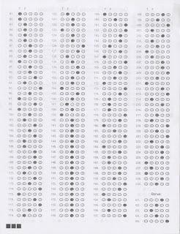
Identify Representative Values
Many values can be selected for each choice.
Partition each choice into types of values.
Consider all outcomes of function.
Consider logical ranges or groupings.
A test specification is a selection of values for all choices.
Concrete test case fills values for each abstract selection.

Slide 16
Values for Each Choice
Parameter: Model
Parameter: Configuration
Choice: Model number
Choice: Configuration Matches Model
malformed
not in database
valid
complete correspondence
omitted slots in configuration
extra slots in configuration
mismatched number of required and optional slots
Choice: Number of required slots
Choice: Number of required slots that are empty
0
1
many
all required slots filled
some required slots empty
all required slots empty
Choice: Number of optional slots
Choice: Number of optional slots that are empty
0
1
many
all optional slots filled
some optional slots empty
all optional slots empty
Choice: Selected components for required slots
Parameter: Product Database
all valid
some kept at default
>= 1 incompatible with slot
>= 1 incompatible with another component
>= 1 not in database
Choice: Number of models in database
0
1
many
Choice: Selected components for optional slots
Number of components in database
all valid
some kept at default
>= 1 incompatible with slot
>= 1 incompatible with another component
>= 1 not in database
0
1
many

Slide 17
Generate Test Case Specifications
Test specification = selection of values for choices.
Constraints limit number of specifications.
1944 tests (all combinations)
678 Tests
Eliminate impossible pairings.
Remove unnecessary options.
Choose a subset to turn into concrete tests.
40 Tests!

Slide 18
Seven choices with three values, one with four values, two with five values.
3⁷ x 5² x 4 = 218700 test specifications
Not all combinations correspond to reasonable specifications.
Values for Each Choice
Parameter: Model
Parameter: Configuration
Choice: Model number
Choice: Configuration Matches Model
malformed
not in database
valid
complete correspondence
omitted slots in configuration
extra slots in configuration
mismatched number of required and optional slots
Choice: Number of required slots
Choice: Number of required slots that are empty
0
1
many
all required slots filled
some required slots empty
all required slots empty
Choice: Number of optional slots
Choice: Number of optional slots that are empty
0
1
many
all optional slots filled
some optional slots empty
all optional slots empty
Choice: Selected components for required slots
Parameter: Product Database
all valid
some kept at default
>= 1 incompatible with slot
>= 1 incompatible with another component
>= 1 not in database
Choice: Number of models in database
0
1
many
Choice: Selected components for optional slots
Number of components in database
all valid
some kept at default
>= 1 incompatible with slot
>= 1 incompatible with another component
>= 1 not in database
0
1
many

Slide 19
Constraints Between Values
IF-CONSTRAINT
This value only needs to be used under certain conditions (if X is true, use value Y)
ERROR
Value causes error regardless of values of other choices.
SINGLE
Only a single test with this value is needed.
Corner cases that should give “good” outcome.

Slide 20
Example - Substring
substr(string | str, | int | index)
Choice: Str length |  |  | Choice: index
length = 0
length = 1
length >= 2
Choice: Str contents contains letters and numbers contains special characters empty
value < 0
value = 0
value = 1
value > 1
property zeroLen, TRUE if length = 0
ERROR
if !zeroLen if !zeroLen if zeroLen
SINGLE

Slide 21
Example - Configuration Constraints
8 (error cases) + 6 (single cases) + (1⁷*2¹*3²) (RSMANY = true/OSMANY = true) + (1⁵*2³*3²) (false/true)
+ (1⁵*2³*3²) (true/false) + (1³*2⁵*3²) (false/false) = 464 test specifications
(after error + single): 8 (error cases) + 6 (single cases) + (1³*2³*3⁴) = 662
218700 test specifications
(after error): 8 (error cases) + (1¹*2³*3⁴*4²) = 10376
Parameter: Model
Parameter: Configuration
Choice: Configuration Matches Model
Choice: Model number
complete correspondence
omitted slots in configuration [error]
extra slots in configuration [error]
mismatched number of required and optional slots [error]
•
not in database
valid
malformed [error]
Choice: Number of required slots
Choice: Number of empty required slots that are empty
0 [single]
1
many
all required slots filled
○
all required slots empty
some required slots empty [if RSMANY]
[property RSMANY]
Choice: Number of optional slots that are empty
Choice: Number of optional slots
all optional slots filled
○
all optional slots empty
0 [single]
1
many
some optional slots empty [if OSMANY]
[property OSMANY]
Choice: Selected components for required slots
all valid
some kept at default [single]
>= 1 incompatible with slot
>= 1 incompatible with another component
>= 1 not in database [error]
Parameter: Product Database
Choice: Number of models in database
0 [error]
1 [single]
many
Choice: Selected components for optional slots
all valid
some kept at default [single]
>= 1 incompatible with slot
>= 1 incompatible with another component
>= 1 not in database [error]
Number of components in database
0 [error]
•
many
1 [single]

Slide 22
Activity - find service
find(pattern,file)
Finds instances of a pattern in a file
find(“john”,myFile)
Finds all instances of john in the file
find(“john smith”,myFile)
Finds all instances of john smith in the file
find(““john” smith”,myFile)
Finds all instances of “john” smith in the file

Slide 23
Activity - find Service
Parameters: pattern, file
What can we vary for each?
What can we control about the pattern? Or the file?
What values can we choose for each choice?
File name:
File exists with that name
File does not exist with that name
What constraints can we apply between choice values? (if, single, error)

Slide 24
Example - find Service
Pattern size:
(2²*3³*4¹) = 432 test specifications
Empty
single character
many characters
File name:
longer than any line in the file
Existing file name
no file with this name
Quoting:
pattern has no quotes
pattern has proper quotes
pattern has improper quotes (only one “)
Number of occurrence of pattern in file:
None
exactly one
more than one
Embedded spaces:
Pattern occurrences on any single line line:
No spaces
One space
Several spaces
One
more than one

Slide 25
ERROR and SINGLE Constraints
4 (error) + 2 (single) + (1²*2³*3¹) = 30
Pattern size:
[error]
Empty
single character
many character
File name:
Existing file name
no file with this name
[error]
[error]
longer than any line in the file
Number of occurrence of pattern in file:
Quoting:
None
exactly one
more than one
pattern has no quotes
pattern has proper quotes
pattern has improper quotes (only one “)
[single]
[error]
Pattern occurrences on target line:
One
more than one
Embedded spaces:
[single]
No spaces
One space
Several spaces
25
27

Slide 26
IF Constraints
4 (error) + 2 (single) + (1³*2³) (quoted = true) + (1⁴*2²) (quoted = false) = 18
Pattern size:
[error]
Empty
single character
many character
File name:
Existing file name
no file with this name
[error]
[error]
longer than any line in the file
Number of occurrence of pattern in file:
Quoting:
None
exactly one
more than one
pattern has no quotes pattern has proper quotes
pattern has improper quotes (only one “)
[single]
[quoted = True ] •
[error]
Pattern occurrences on target line:
One
more than one
Embedded spaces:
[single]
No spaces
One space
Several spaces
[if quoted]
[if quoted]
26
27

Slide 27
Let’s take a break.

Slide 28
Combinatorial Interaction Testing

Slide 29
Limiting Num. of Test Specifications
Bandwidth Mode | Language | Fonts
Desktop Site | English | Standard
Mobile Site | French | Open-Source
Text Only | German | Minimal
 | Swedish
Advertising | Screen Size
No Advertising | Phone
Targeted Advertising | Tablet
General Advertising | Full Size
Minimal Advertising
Full set = 432 specifications
No natural IF, SINGLE, ERROR constraints for these features.
What is important to cover?

Slide 30
Combinatorial Interaction Testing
Cover all k-way interactions (k < N).
Typically 2-way (pairwise) or 3-way.
Set of all combinations grows exponentially.
Set of pairwise combinations grows logarithmically.
(last slide) 432 combinations.
Possible to cover all pairs in 16 tests.

Slide 31
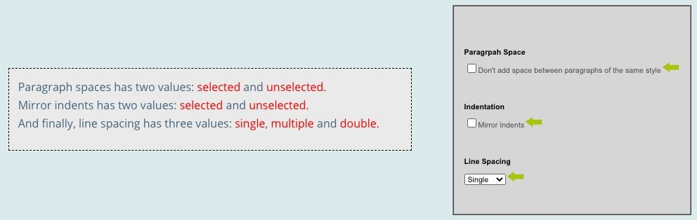
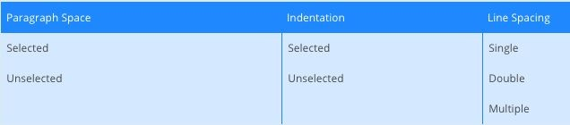
Example - Paragraph Effects
2 * 2 * 3 = 12
combinations

Slide 32
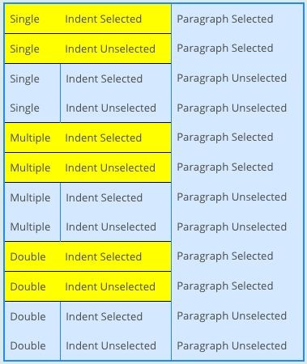
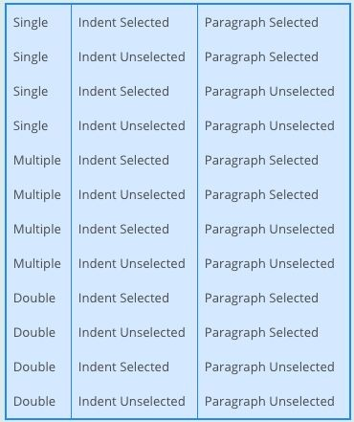
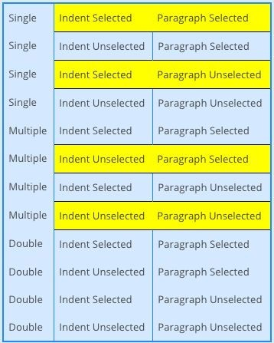
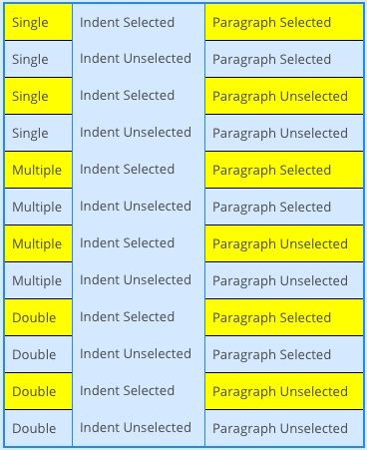
Example - Paragraph Effects

Slide 33
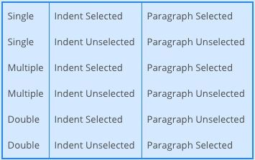
Example - Paragraph Effects
Goal of CIT is to produce
covering array.
Set of configurations that covers all K-way combinations.
(2-way here).
Cover in 6 test specifications.

Slide 34
Example - Website Display
Bandwidth Mode
Bandwidth Mode | Fonts | Screen Size
Desktop Site | Standard | Phone
Desktop Site | Open-Source | Tablet
Desktop Site | Minimal | Full Size
Mobile Site | Standard | Tablet
Mobile Site | Open-Source | Full Size
Mobile Site | Minimal | Phone
Text Only | Standard | Full Size
Text Only | Open-Source | Phone
Text Only | Minimal | Tablet
Cover all combinations for two variables.
Add a third, account for all combinations of pairs of values.
Desktop Site
Mobile Site
Text Only
Fonts
Each test specification can cover up to three pairs.
Standard
Open-Source
Minimal
Screen Size Phone Tablet
Full Size

Slide 35
Bandwidth Mode
Language
Advertising
Fonts
Screen Size
English
No Advertising
Desktop Site
Standard
Phone
Example
English
Targeted Advertising
Mobile Site
Open-Source
Tablet
English
General Advertising
Text Only
Minimal
Full Size
Bandwidth Mode | Language | Fonts
Desktop Site | English | Standard
Mobile Site | French | Open-Source
Text Only | German | Minimal
 | Swedish
Advertising | Screen Size
No Advertising | Phone
Targeted Advertising | Tablet
General Advertising | Full Size
Minimal Advertising
English
Minimal Advertising
Mobile Site
Minimal
Phone
-
French
No Advertising
-
-
-
French
Targeted Advertising
Desktop Site
Minimal
Full Size
French
General Advertising
Mobile Site
Standard
Tablet
French
Minimal Advertising
Text Only
Open-Source
Phone
German
No Advertising
Text Only
Minimal
Tablet
German
Targeted Advertising
-
-
-
German
General Advertising
Desktop Site
Open-Source
Phone
German
Minimal Advertising
Mobile Site
Standard
Full Size
Swedish
No Advertising
Mobile Site
Open-Source
Full Size
Swedish
Targeted Advertising
Text Only
Standard
Phone
Swedish
General Advertising
-
-
-
Swedish
Minimal Advertising
Desktop Site
Minimal
Tablet
37

Slide 36
Constraints
Remove all ERROR/SINGLE cases before CIT.
Error output, one-time corner cases
Constraints on value combinations specified:
OMIT(Text-Only, *, *, Full Size, *)
OMIT(*, *, *, Full Size, Minimal)
Further reduces number of test specifications.

Slide 37
CIT Tools
Pairwise Independent Combinatorial Testing (Microsoft): https://github.com/microsoft/pict
Automated Combinatorial Testing for Software
(NIST):
https://csrc.nist.gov/projects/automated-combinatori al-testing-for-software
.. Many more: https://www.pairwise.org/tools.html

Slide 38
Activity - Browser Configuration
Allow Content to Load | Notify About Pop-Ups | Allow Cookies | Warn About Add-Ons | Warn About Attack Sites | Warn About Forgeries
Allow | Yes | Allow | Yes | Yes | Yes
Restrict | No | Restrict | No | No | No
Block |  | Block
Full set of test specifications = 144
Create set covering all pairwise value combinations.
Hint: Start with two variables with most values. Add one
variable at a time.

Slide 39
Activity Solution
Allow Content | Allow Cookies | Pop-Ups | Add-Ons | Attacks | Forgeries
Allow | Allow | Yes | Yes | Yes | Yes
Allow | Restrict | No | No | Yes | No
Allow | Block |  |  | No | Yes
Restrict | Allow |  | - | No | No
Restrict | Restrict | Yes | - | - | Yes
Restrict | Block | No | Yes | Yes | No
Block | Allow | No | - | - | Yes
Block | Restrict | - | Yes | No | -
Block | Block | Yes | No | Yes | No
Allow Content | Allow Cookies | Pop-Ups | Add-Ons | Attacks | Forgeries
Allow | Allow | Yes | Yes | Yes | Yes
Allow | Restrict | No | No | Yes | No
Allow | Block | No | No | No | Yes
Restrict | Allow | Yes | - | No | No
Restrict | Restrict | Yes | - | - | Yes
Restrict | Block | No | Yes | Yes | No
Block | Allow | No | - | - | Yes
Block | Restrict | - | Yes | No | -
Block | Block | Yes | No | Yes | No
-
-
-

Slide 40
We Have Learned
Process for deriving system-level tests often results in too many test specifications.
Two methods that identify important interactions:
Category-Partition Method: Use constraints to eliminate unnecessary tests.
Combinatorial Interaction Testing: Identify important pairs of input values.

Slide 41
Next Time
Exercise Session Tomorrow:
More practice in system-level testing.
Unit Testing

Slide 42
Thank You

